Slide 1
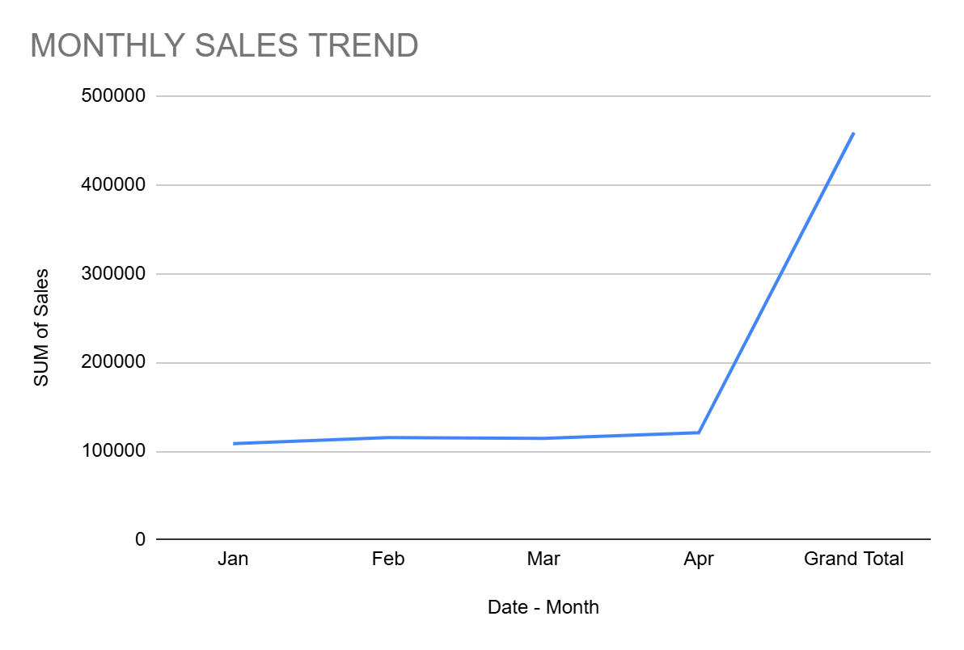
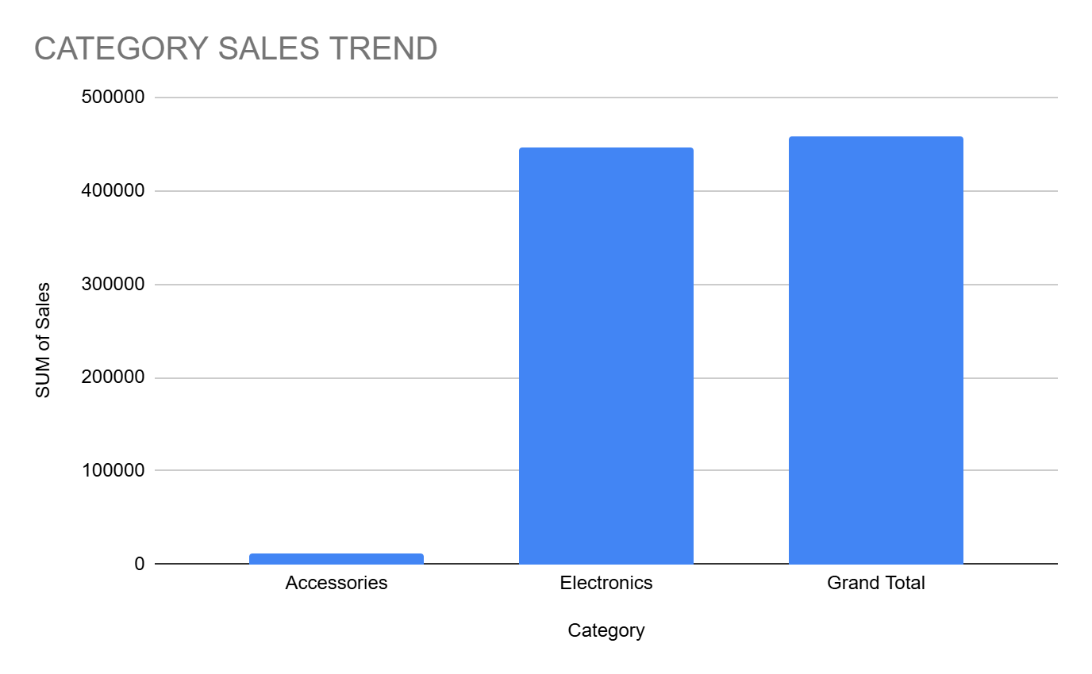
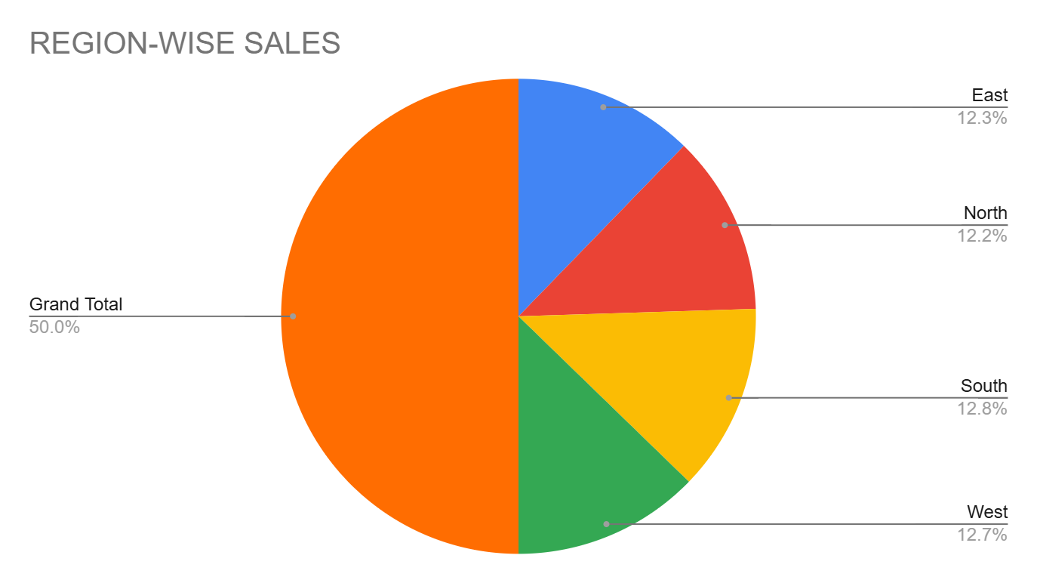
SALES PERFORMANCE DASHBOARD
TOTAL SALES
4,59,000
AVERAGE SALES
22,950
TOTAL ORDERS
20
TOP PRODUCT
Laptop

